Slide 1
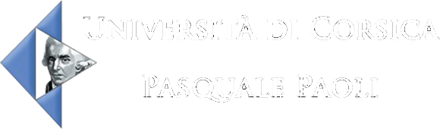

Encadrants :
BISGAMBIBLIA Paul-Antoine
COLIN Fréderic
CUVILLIER Gabriel
FOURES Damien
NIVET Marie-Laure
URBANI Dominique
RAYA VACA Carlos Alberto
Master 2 SII
Décembre 2015

Slide 2
PLAN
Présentation du projet
Planning du projet
Problèmes rencontres
L’évolution du projet
Conclusion

Slide 3
1.
Le besoin

Slide 4
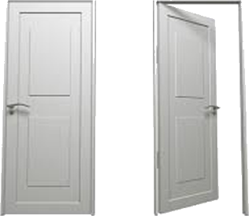
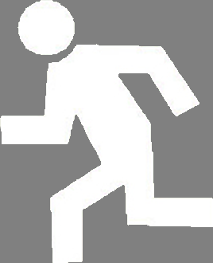

Slide 5


Slide 6


Slide 7


Slide 10
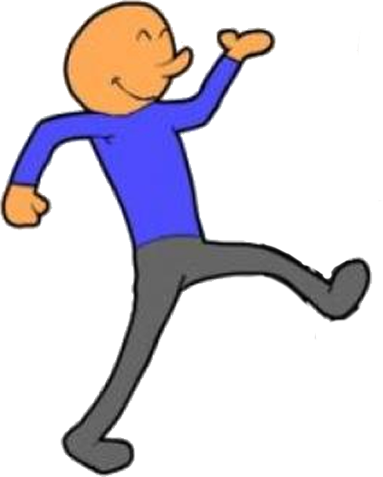

Slide 14
2.
A l’ataque

Slide 15
L’idée

Slide 16

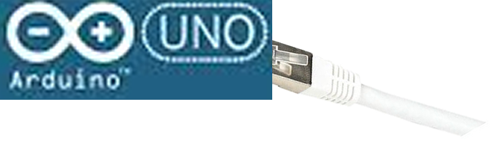





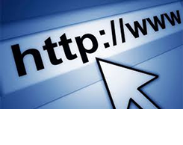
INTERNET

Slide 17

Modelisation DEVS

Slide 18
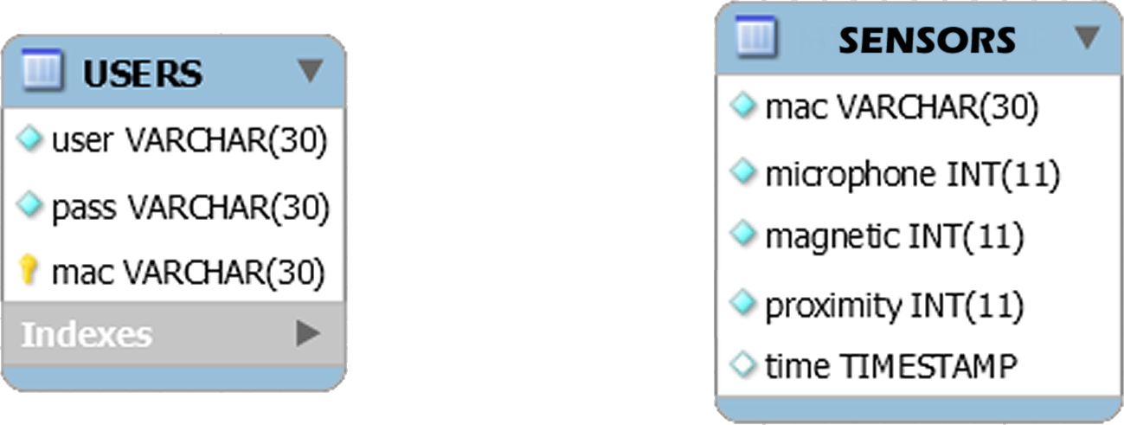
Base de donees

Slide 19
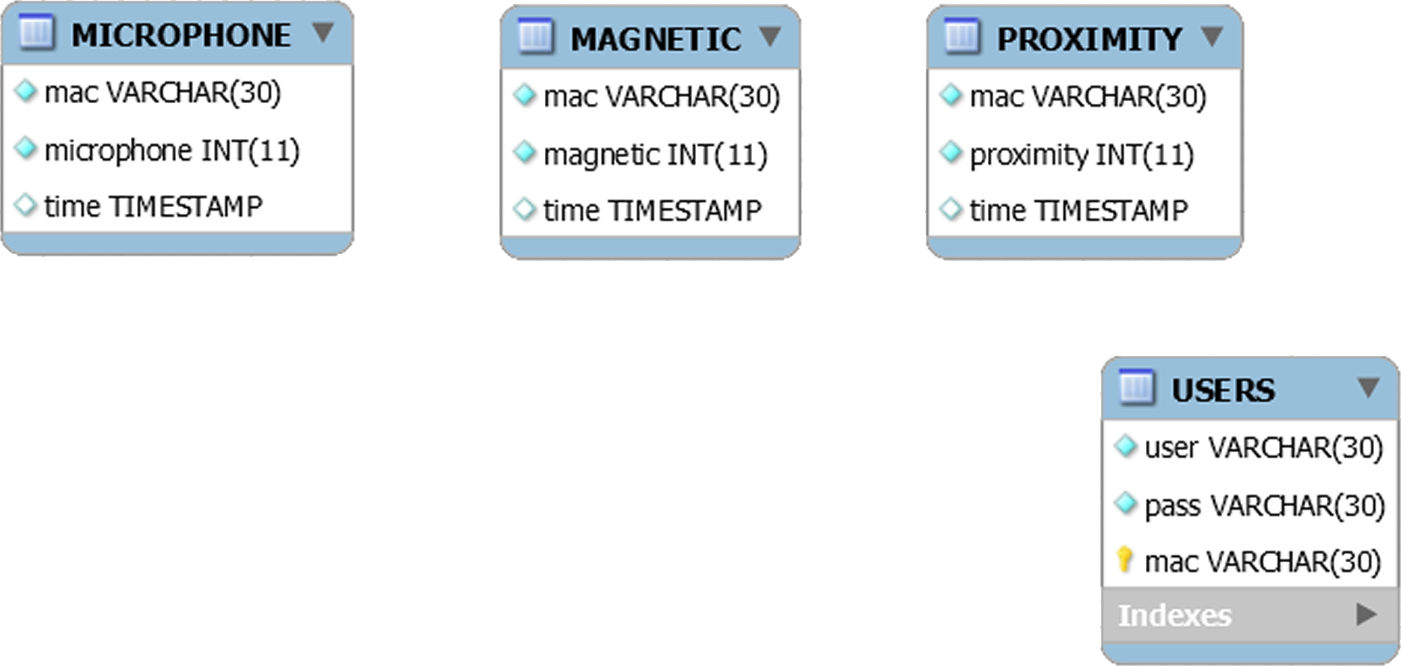
…Apres le modele DEVSimPy

Slide 20
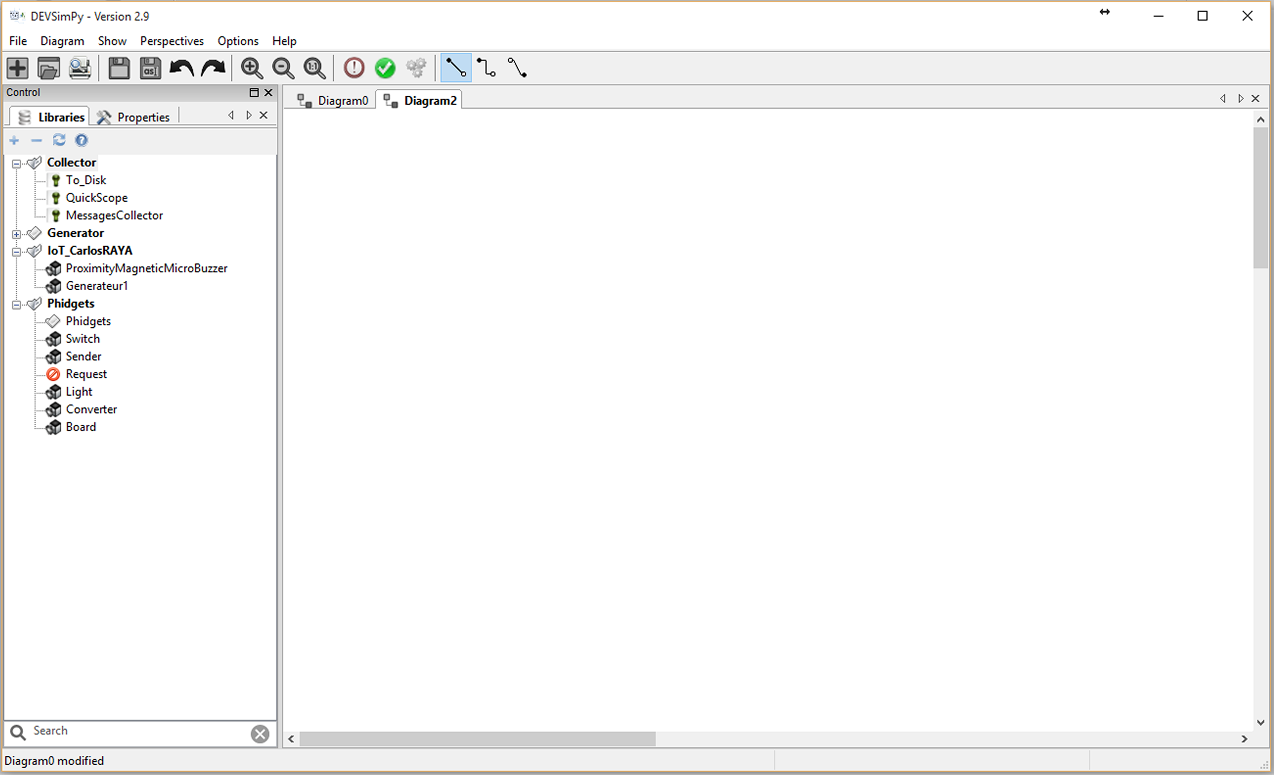
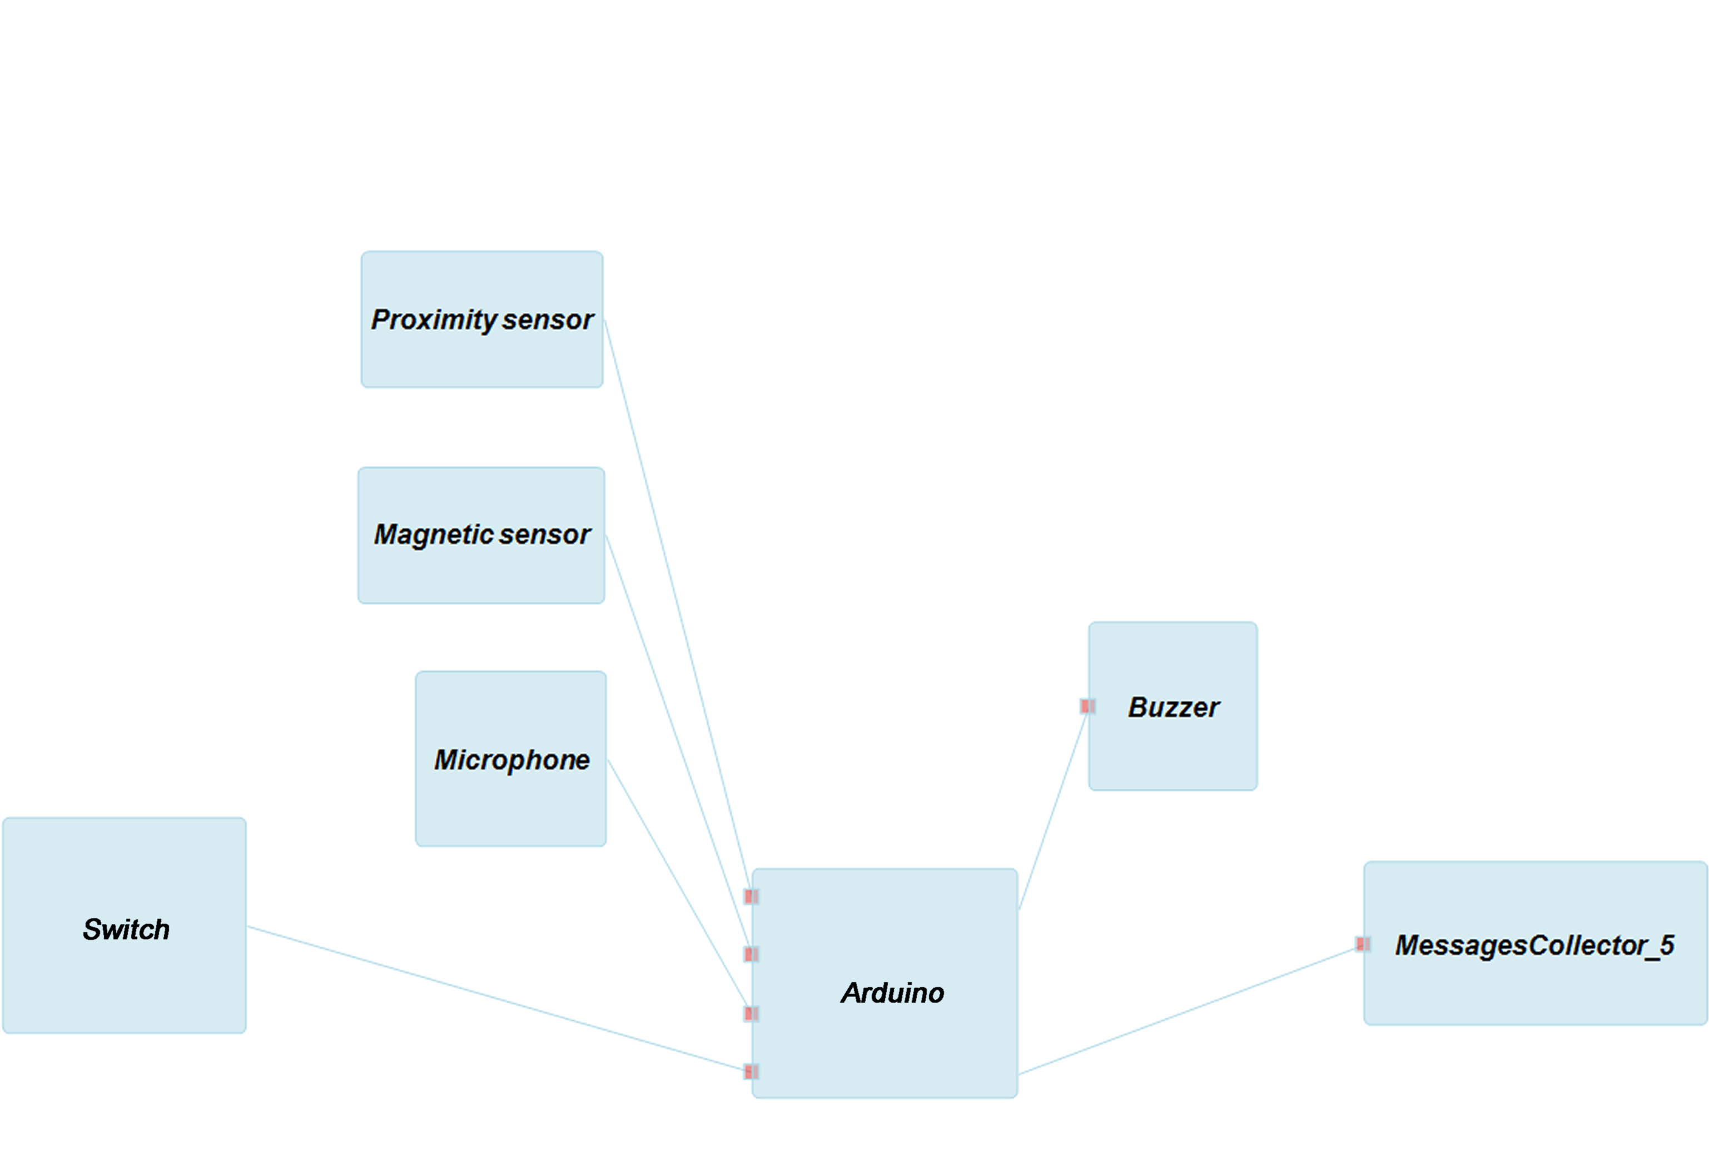

Slide 21
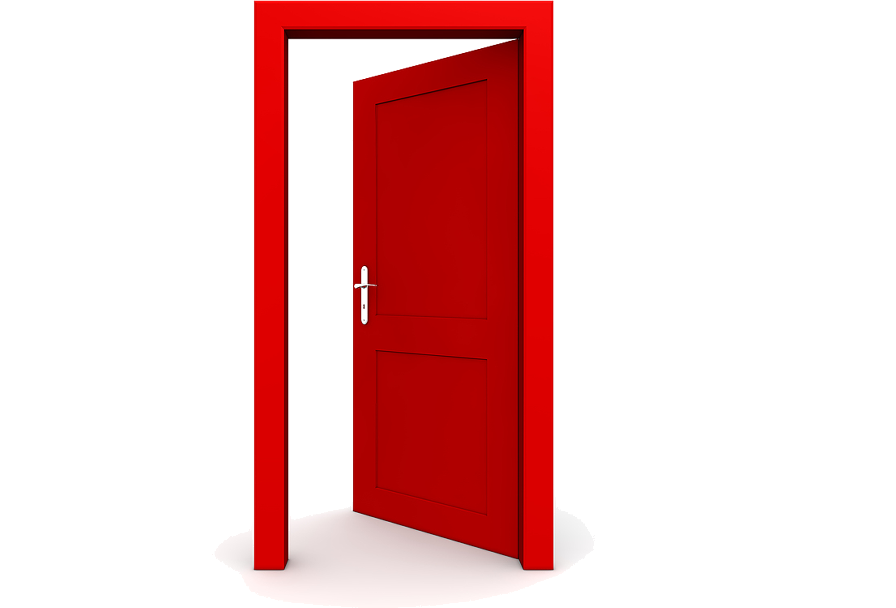

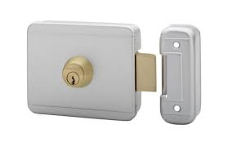

Toto arrive en 5 minutes ! ! !

Slide 22
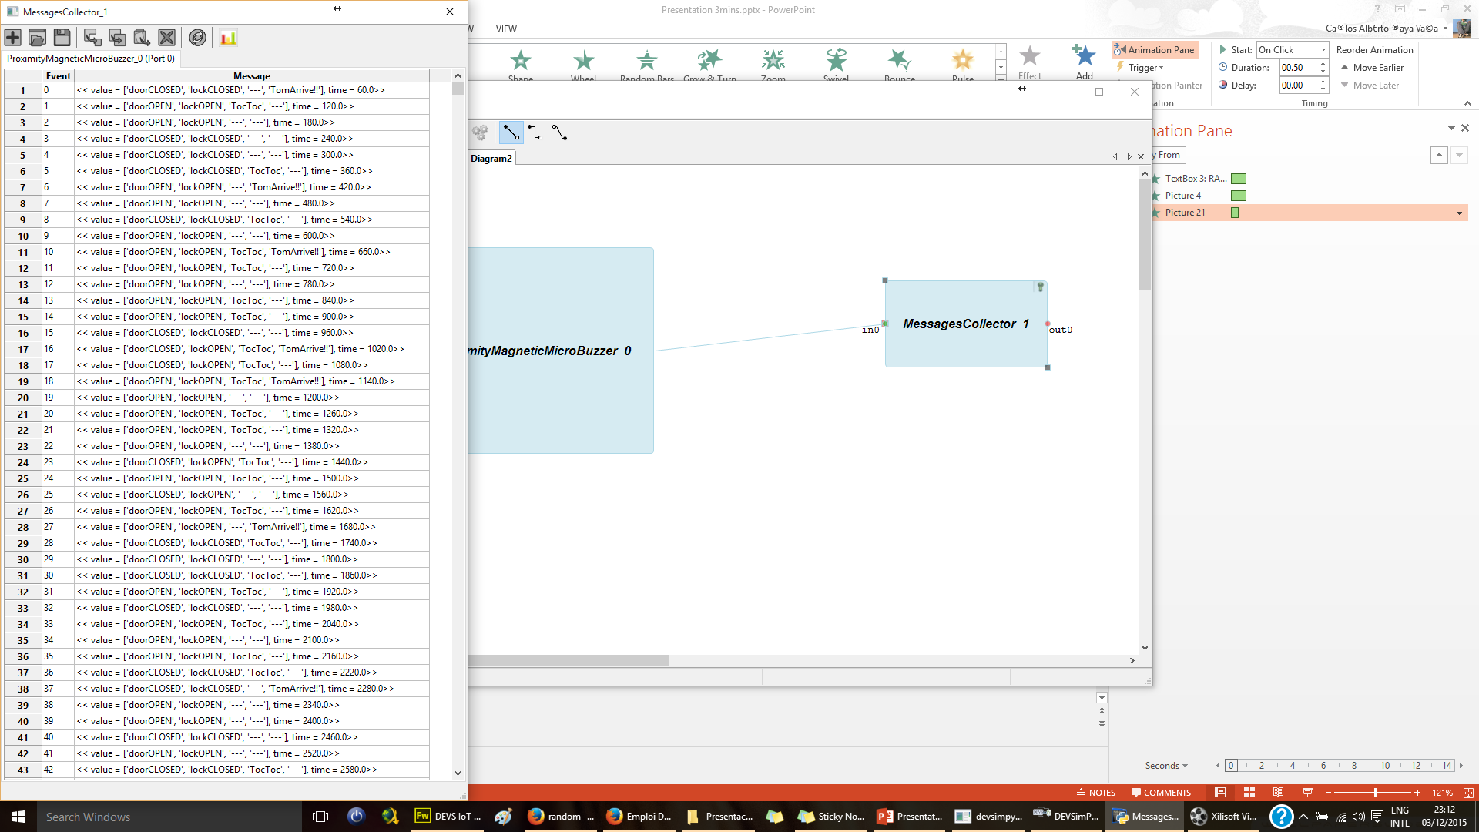
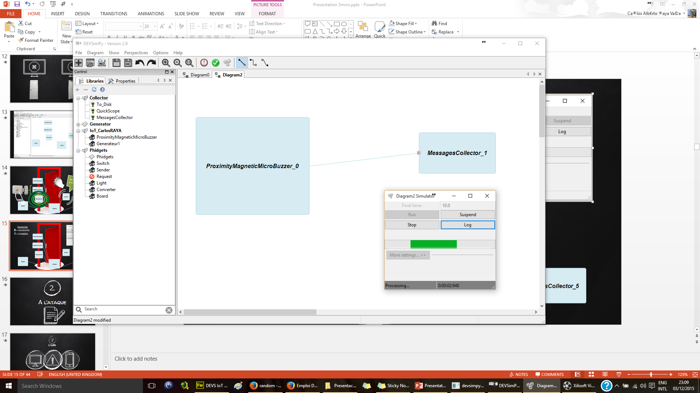
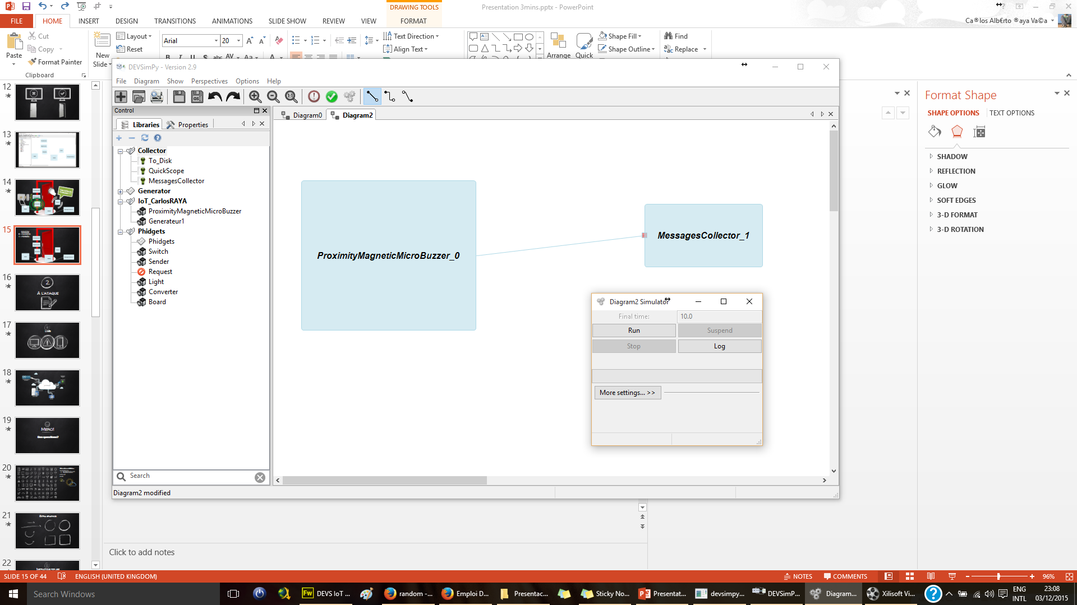
RANDOM
0 = OUVERTE
1 = FERMÉE

Slide 24
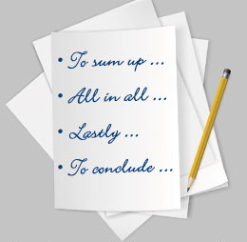
Conclusion
DEVSimPy
de temps
Prévenir et éviter
Adapter le projet
Notes:
DEVSimPy est un outil très puissante pour faire des modèles d’une situation réelle.
Simulation = résultats en moins de temps
Prévenir et éviter futurs problèmes pendant le développement du projet.
Adapter le projet à la simulation d’une situation réelle avant de tout coder

Slide 25
Merci!
Des questions?

Slide 26
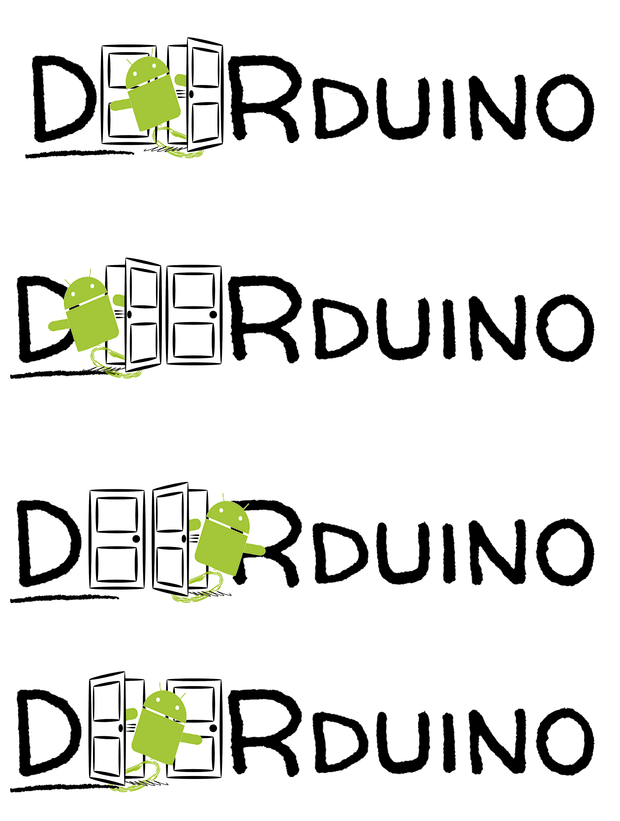

Slide 27
SlidesCarnival icons are editable shapes.
This means that you can:
Resize them without losing quality.
Change fill color and opacity.
Isn’t that nice? :)
Examples:

Slide 28
Extra graphics

Slide 29
Instructions for use
Open this document in Google Slides (if you are at slidescarnival.com use the button below this presentation)
You have to be signed in to your Google account
EDIT IN GOOGLE SLIDES
Go to the File menu and select Make a copy.
You will get a copy of this document on your Google Drive and will be able to edit, add or delete slides.
EDIT IN POWERPOINT®
Go to the File menu and select Download as Microsoft PowerPoint. You will get a .pptx file that you can edit in PowerPoint.
Remember to download and install the fonts used in this presentation (you’ll find the links to the font files needed in the Presentation design slide)
More info on how to use this template at www.slidescarnival.com/help-use-presentation-template
This template is free to use under Creative Commons Attribution license. If you use the graphic assets (photos, icons and typographies) provided with this presentation you must keep the Credits slide.

Slide 30
hello!
I am Jayden Smith
I am here because I love to give presentations.
You can find me at @username

Slide 31
This is a slide title
Here you have a list of items
And some text
But remember not to overload your slides with content
You audience will listen to you or read the content, but won’t do both.

Slide 32
Big concept
Bring the attention of your audience over a key concept using icons or illustrations

Slide 33
You can also split your content
White
Is the color of milk and fresh snow, the color produced by the combination of all the colors of the visible spectrum.
Black
Is the color of coal, ebony, and of outer space. It is the darkest color, the result of the absence of or complete absorption of light.

Slide 34
In two or three columns
Yellow
Is the color of gold, butter and ripe lemons. In the spectrum of visible light, yellow is found between green and orange.
Blue
Is the colour of the clear sky and the deep sea. It is located between violet and green on the optical spectrum.
Red
Is the color of blood, and because of this it has historically been associated with sacrifice, danger and courage.

Slide 35
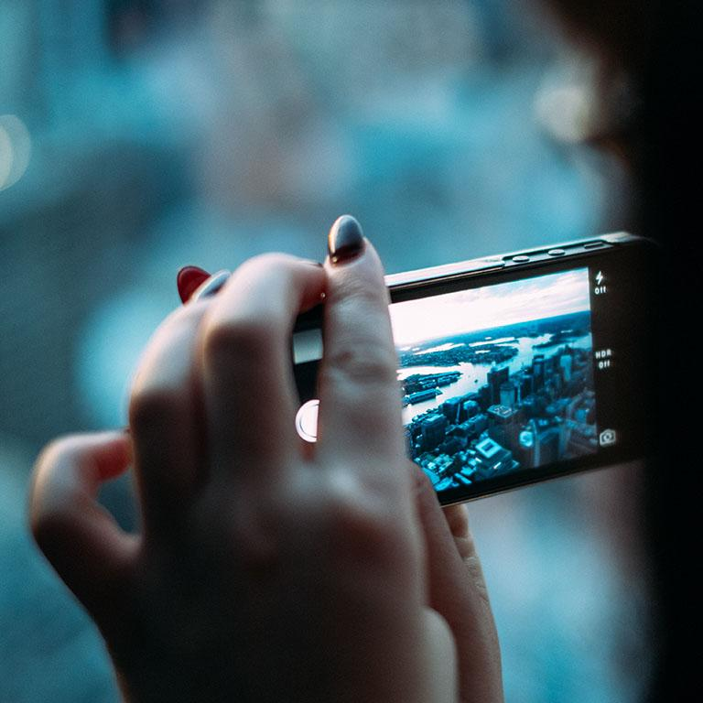
A picture is worth a thousand words
A complex idea can be conveyed with just a single still image, namely making it possible to absorb large amounts of data quickly.

Slide 36
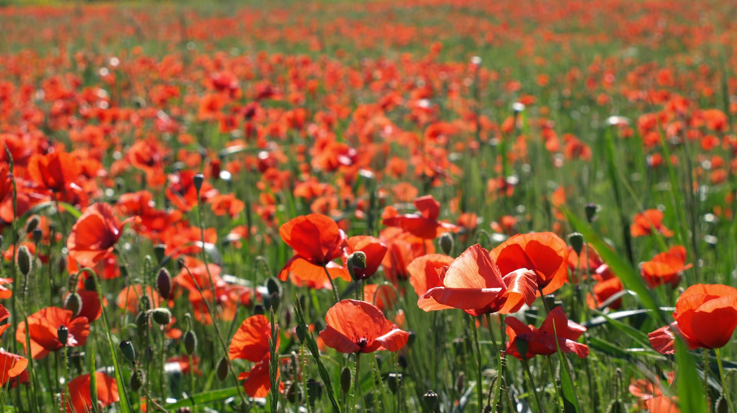
Want big impact?
Use big image.

Slide 37
Use charts to explain your ideas
White
Gray
Black

Slide 38
And tables to compare data
 | A | B | C
Yellow | 10 | 20 | 7
Blue | 30 | 15 | 10
Orange | 5 | 24 | 16

Slide 39
Maps
our office

Slide 40
89,526,124
Whoa! That’s a big number, aren’t you proud?

Slide 41
89,526,124$
185,244 users
100%
That’s a lot of money
And a lot of users
Total success!

Slide 42
Our process is easy
first
second
last

Slide 43
Let’s review some concepts
Yellow
Is the color of gold, butter and ripe lemons. In the spectrum of visible light, yellow is found between green and orange.
Blue
Is the colour of the clear sky and the deep sea. It is located between violet and green on the optical spectrum.
Red
Is the color of blood, and because of this it has historically been associated with sacrifice, danger and courage.
Yellow
Is the color of gold, butter and ripe lemons. In the spectrum of visible light, yellow is found between green and orange.
Blue
Is the colour of the clear sky and the deep sea. It is located between violet and green on the optical spectrum.
Red
Is the color of blood, and because of this it has historically been associated with sacrifice, danger and courage.

Slide 44
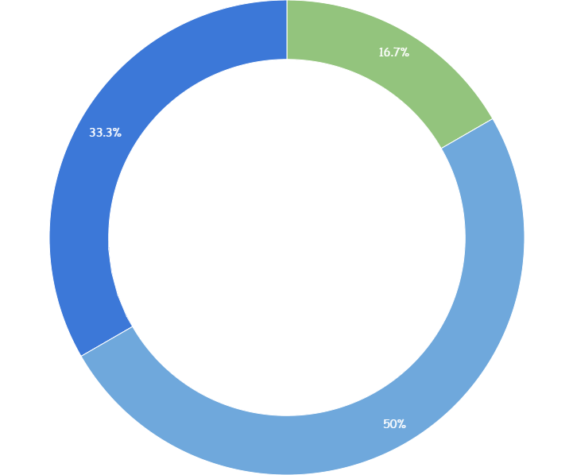
You can copy&paste graphs from Google Sheets

Slide 45
Place your screenshot here
Android project
Show and explain your web, app or software projects using these gadget templates.

Slide 46
Place your screenshot here
iPhone project
Show and explain your web, app or software projects using these gadget templates.

Slide 47
Place your screenshot here
Tablet project
Show and explain your web, app or software projects using these gadget templates.

Slide 48
Place your screenshot here
Desktop project
Show and explain your web, app or software projects using these gadget templates.

Slide 49
thanks!
Any questions?
You can find me at
@username
user@mailme

Slide 50
Credits
Special thanks to all the people who made and released these awesome resources for free:
Presentation template by SlidesCarnival
Photographs by Unsplash

Slide 51

Presentation design
This presentation uses the following typographies and colors:
Titles: Walter Turncoat
Body copy: Sniglet
You can download the fonts on this page:
https://www.google.com/fonts#UsePlace:use/Collection:Sniglet:400|Walter+Turncoat
Click on the “arrow button” that appears on the top right
White #FFFFFF
You don’t need to keep this slide in your presentation. It’s only here to serve you as a design guide if you need to create new slides or download the fonts to edit the presentation in PowerPoint®

